Slide 1
Food and Farm Facts Jeopardy

Slide 2
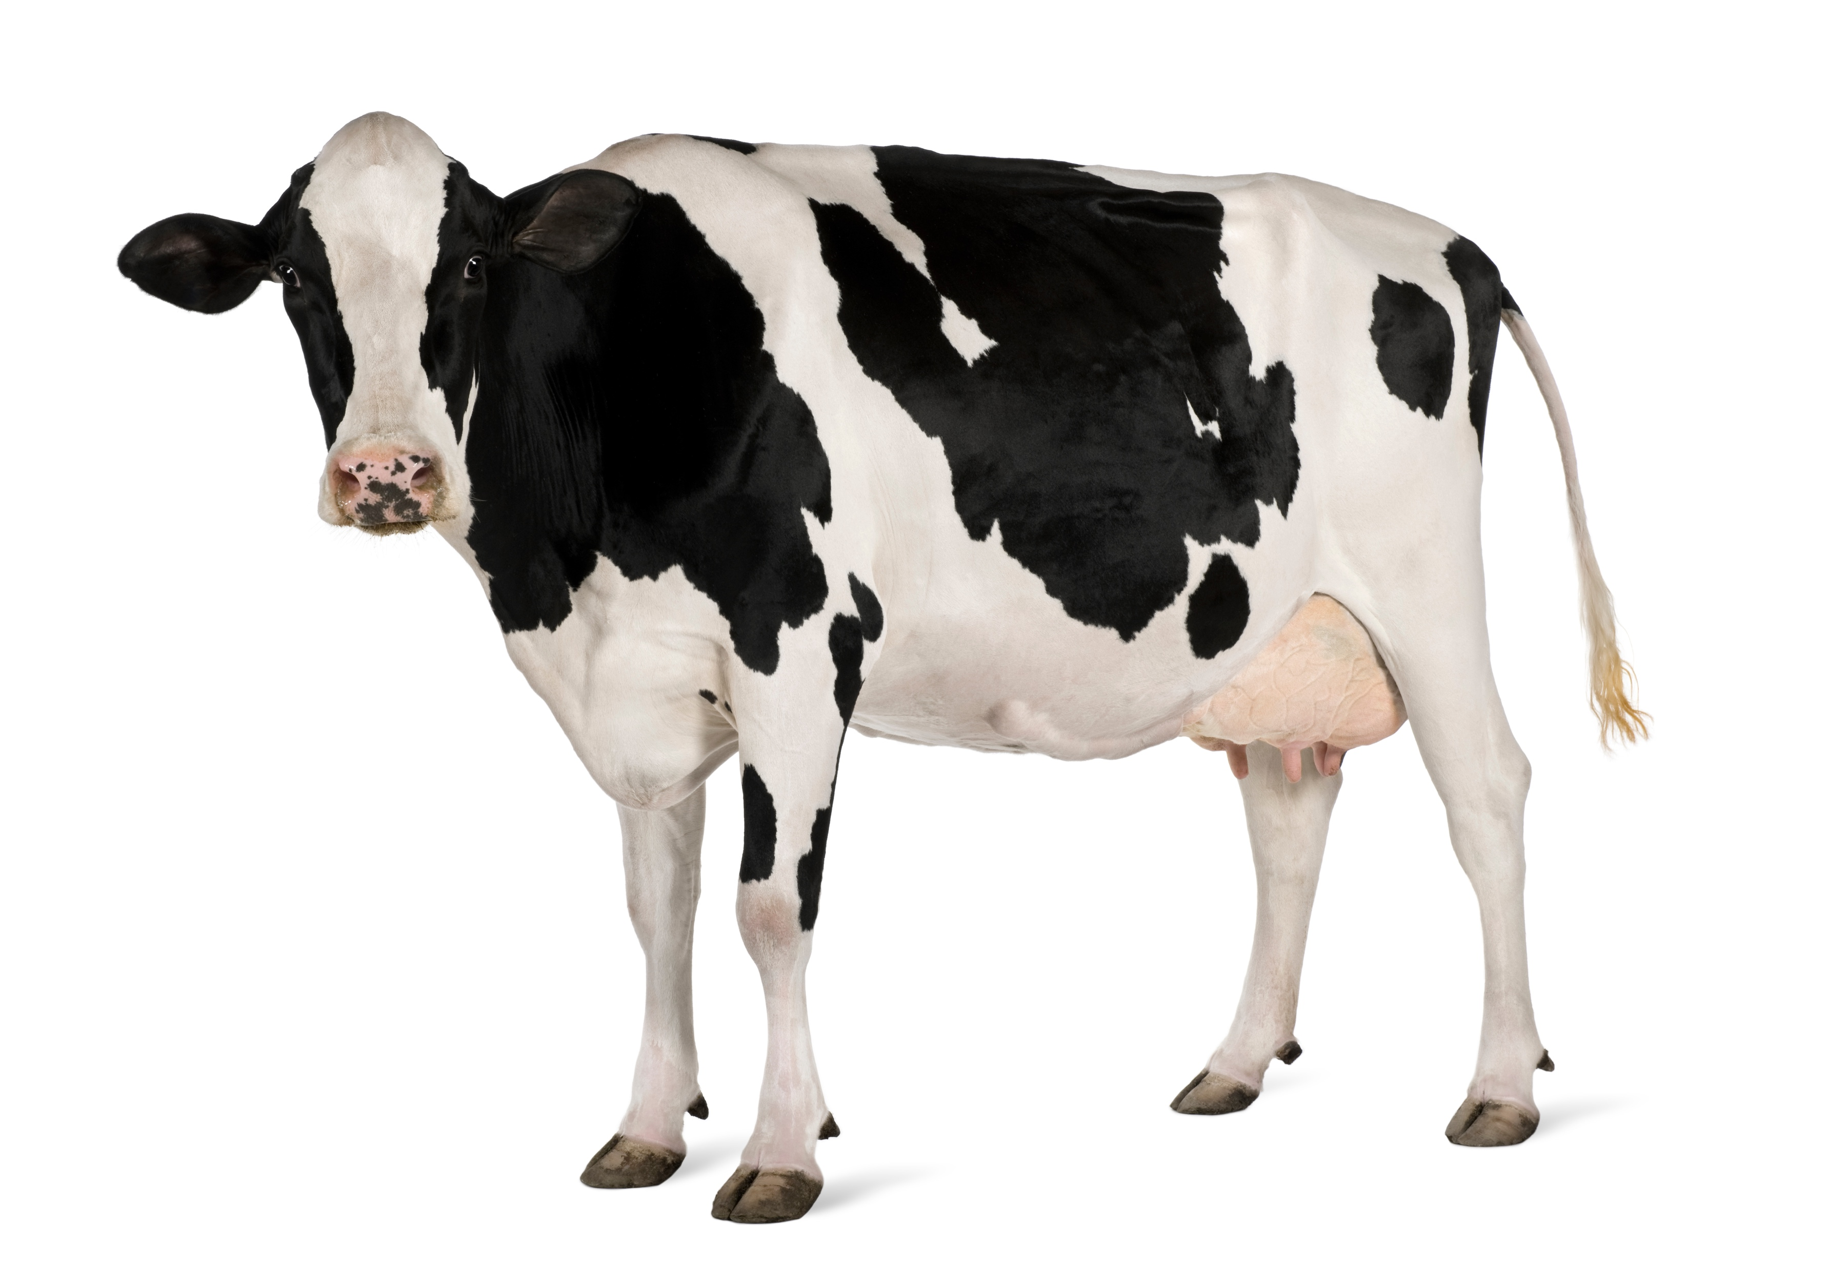
Directions
Students are broken into small groups.
Students pick a category and a point value.
Students must give the answer in the form of a question before clicking again.
If the student or team is correct, they are awarded the point value of the question.
Click on the home icon in the bottom right of each slide to return to the main category screen.
Continue until all questions have been answered.
Keep track of each team’s points. The team with
the most points wins!

Slide 3
JEOPARDY CATEGORIES
Consumers
Modern Farmers
Trade & Economics
Environment
Production
Ag History
$100
$100
$100
$100
$100
$100
$200
$200
$200
$200
$200
$200
$300
$300
$300
$300
$300
$300
$400
$400
$400
$400
$400
$400
$500
$500
$500
$500
$500
$500
$600
$600
$600
$600
$600
$600
$700
$700
$700
$700
$700
$700
$800
$800
$800
$800
$800
$800
Final Jeopardy
Notes:
Students are broken into small groups. They pick a category and a point value. Students must give the answer in the form of a question before clicking again. If the student or team is correct, they are awarded the point value of the question. Continue until all questions have been answered. The team with the most points wins.

Slide 4
Consumers - $100
The two youth programs that specifically teach about agriculture
What are 4-H and FFA?

Slide 5
Consumers - $200
The percentage of the population that are U.S. farmers and ranchers
What is 2%?

Slide 6
Consumers - $300
The percentage of their disposable income U.S. consumers spend on food each year
What is 9%?

Slide 7
Consumers - $400
The percentage of their income U.S. consumers spend on eating out
What is 48%?

Slide 8
Consumers - $500
The holiday that generates the most revenue spent on food
What is Superbowl Sunday?

Slide 9
Consumers - $600
The percentage of food grown and produced in the U.S. that is never eaten
What is 40%?

Slide 10
Consumers - $700
The percentage of food Americans throw away at home
What is 25%?

Slide 11
Consumers - $800
The percentage of farms that market their products directly to consumers or locally
What is 8%?

Slide 12
Modern Farmers - $100
The number of people each American farm produces food and fiber for annually in the U.S. and abroad
What is 172?

Slide 13
Modern Farmers - $200
The number of farms in the United States
What is two million?

Slide 14
Modern Farmers - $300
The top U.S. commodity with nearly 960 billion pounds produced annually
What are grains (corn, wheat, oats, rice, barley, rye, sorghum)?

Slide 15
Modern Farmers - $400
The average age of a farmer in the U.S.
What is 58?

Slide 16
Modern Farmers - $500
The percentage of women farm operators
What is 36%?

Slide 17
Modern Farmers - $600
The state with the most farms
What is Texas?

Slide 18
Modern Farmers - $700
The percentage of all farmers age 34 and under
What is 8%?

Slide 19
Modern Farmers - $800
441 acres
What is the average U.S. farm size?

Slide 20
Trade & Economics - $100
The country that receives the most U.S. agricultural products exports
What is China?

Slide 21
Trade & Economics - $200
The percentage of the USDA budget for agriculture programs
What is 22%?

Slide 22
Trade & Economics - $300
Most of the USDA budget is used for these programs
What are the food assistance and nutrition programs?

Slide 23
Trade & Economics - $400
The amount of money farmers and ranchers receive on average out of every retail dollar spent on food that is eaten at home and away from home
What is 14 cents?

Slide 24
Trade & Economics - $500
The top farm production expense
What is fertilizer, seed, crop-protecting chemicals?

Slide 25
Trade & Economics - $600
The top import commodities (based on value)
What is fresh and processed fruits ($18.6 billion)?

Slide 26
Trade & Economics - $700
The top export commodities (based on value)
What is soybeans ($25.7 billion)?

Slide 27
Trade & Economics - $800
These three countries make up nearly 45% of all U.S. agricultural exports
What is China, Canada, and Mexico?

Slide 28
Environment- $100
The percent of all U.S. farmland used for conservation and wildlife habitat.
What is 15%?

Slide 29
Environment - $200
Sand, silt, clay, organic matter, water and microorganisms are all a part of this medium
What is soil?

Slide 30
Environment - $300
The sustainable soil use and resource conservation efforts increased by how many acres in five years?
What is 34 million acres?

Slide 31
Environment - $400
___% fewer acres required to produce soybeans in 2018 than it would have in 1990?
What is 33%?

Slide 32
Environment - $500
U.S. farmers are managing and preserving soil by
What is planting cover crops, increasing conservation tillage, or expanding no-till methods?

Slide 33
Environment - $600
To match 2018 production levels, U.S. agriculture would have needed how many more acres in 1990?
What is nearly 100 million more acres?

Slide 34
Environment - $700
Agriculture accounts for what percent of total U.S. greenhouse gas emissions?
What is less than 10%?

Slide 35
Environment - $800
The percent of acres required to produce corn in 2018
What is 81 million acres?

Slide 36
Production - $100
Biotechnology in crops globally reduced this input by 8.6%
What is pesticides?

Slide 37
Production - $200
The top states for aquaculture sales (by value)
What is Mississippi, Washington, Louisiana, Virginia, and California?

Slide 38
Production - $300
The main crop in ethanol
What is corn?

Slide 39
Production - $400
A football field is roughly the size of this type of measurement
What is an acre of land?

Slide 40
Production - $500
The production of aquatic animals and plants under controlled conditions
What is aquaculture?

Slide 41
Production - $600
The number of loaves of white bread one bushel of wheat can produce
What is 70 one-pound loaves?

Slide 42
Production - $700
The percentage of U.S. Forests owned by federal, state and local governments
What is 42%?

Slide 43
Production - $800
The U.S. forest planting averages about how many acres per year?
What is 2.1 million acres ?

Slide 44
Ag History - $100
The year Christopher Columbus brought calves, goats, sheep, pigs, hens, citrus, melons and many kinds of vegetables to America
What is 1493?

Slide 45
Ag History - $200
The year John (Johnny Appleseed) Chapman planted some of his first apple trees in western Pennsylvania
What is 1798?

Slide 46
Ag History - $300
The year John Deere began manufacturing steel plows
What is 1837?

Slide 47
Ag History - $400
The year Michigan and Pennsylvania established the first state agricultural colleges
What is 1855?

Slide 48
Ag History - $500
The year hybridized corn was produced
What is 1881?

Slide 49
Ag History - $600
The year the first National School Lunch Act was enacted
What is 1946?

Slide 50
Ag History - $700
The year the first weed- and insect-resistant biotech crops — soybeans and cotton — were available commercially and a sheep named “Dolly” was the first mammal cloned
What is 1997?

Slide 51
Ag History - $800
The year the USDA unveiled organic standards for foods and the official organic seal
What is 2000?

Slide 52
FINAL JEOPARDY
The percentage of of U.S. farms owned by families/individuals, family partnerships or family corporations
What is 98%?

