Slide 1
Welcome to
My American Farm

Slide 2
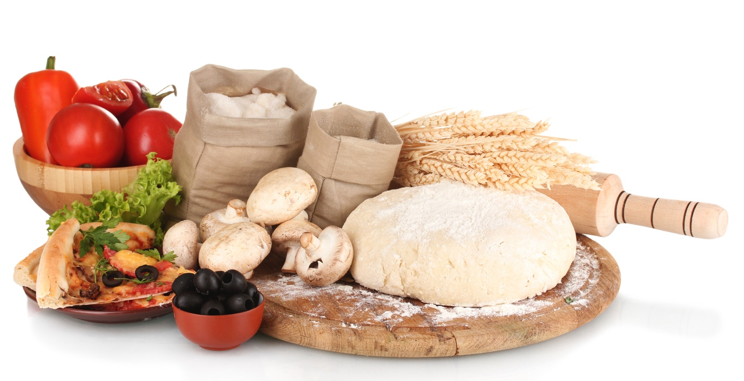
Where Does Pizza Come From?
Your favorite pizza originates on America’s farms and ranches. Top-Producing States:
SAUSAGE (From Hogs) Iowa, Minnesota, North Carolina
ONIONS
California, Georgia, Texas
PINEAPPLE
Hawaii
TOMATO SAUCE (Fresh Tomatoes)
California, Florida
SPINACH
California, Arizona
MUSHROOMS
Pennsylvania, California
GREEN PEPPERS
California, Florida
PIZZA DOUGH (Winter Wheat)
Kansas, Montana, Colorado
MOZZARELLA CHEESE (Dairy Products)
California, Wisconsin, New York
Notes:
Your favorite pizza originates on America’s farms and ranches.
Each year, Americans consume more than 3 billion pizzas. If you look at it another way, the average family eats pizza at home 30 times each year.
Sources: USDA – NASS; American Pizza Community; AFBF

Slide 3
AGRICULTURE!

Slide 4
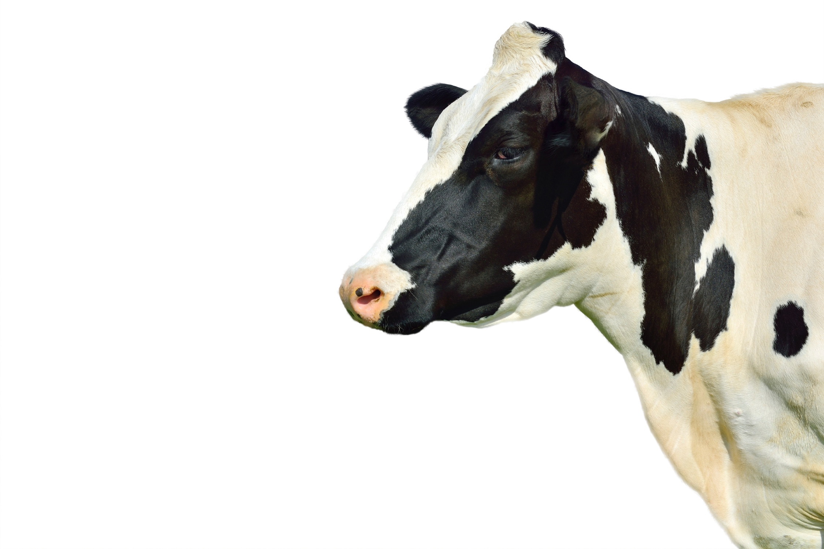
What Do Farmers & Ranchers Grow?
Top 5 U.S. Commodities in Billions
975.7 lbs Grains
455.1 lbs Hay and Silage
259.3 lbs Oilseeds
206.0 lbs Dairy Products
115.9 lbs Horticulture
Notes:
Annual production of food grown in the United States.
Total Annual Production: 2.3 Trillion Pounds
Crops = 87% Livestock = 13%
Top Commodities:
Grains (Corn, Wheat, Oats, Rice, Barley, Rye, Sorghum and Millet)
Hay and Silage
Oilseeds (Soybeans, Sunflowers, Peanuts, Canola, Cottonseed, Mustard Seed, Flaxseed, Rapeseed and Safflower)
Dairy Products
Horticulture (Vegetables, Citrus, Non-citrus Fruits and Nuts)
Cotton, Tobacco, Sugar Beets and Sugarcane
Poultry (Turkeys and Broilers)
Potatoes, Sweet Potatoes, Coffee, Hops, Peppermint Oil, Spearmint Oil and Taro
Beef and Veal Pork Eggs Dry Beans, Peas and Lentils
Sources: USDA—ERS; USDA—NASS; WAOB; AFBF

Slide 5
How Are You Connected to Agriculture?
Personal Care Products Shampoo, soap, cosmetics, lotions, fingernail polish, toothpaste
Construction Lumber, paints, brushes, tar paper, drywall, tool handles, particle board
Health Care Pharmaceuticals, surgical sutures, ointments, latex gloves, x-ray film
Education Crayons, text books, chalk, desks, pencils, paper
Manufacturing Adhesives, lubricants, solvents, detergents, polymers
Entertainment Film, strings for musical instruments
Sports Uniforms, baseball bats, leather equipment and balls, shoes
Transportation Biofuels including ethanol and biodiesel, lubricants, antifreeze, tires, upholstery, packing materials
Printing Paper, ink, film
Notes:
We are connected to agriculture in many ways beyond the food that’s in our refrigerators at home. Products we use in our everyday lives come from plants and animals produced by America’s farmers and ranchers.
Source: USDA - Agricultural Outlook

Slide 6
How Many People Does One Farmer Feed?
Each U.S. Farm Feeds 169 People
Notes:
Sources: AFBF; FAO; Census of Agriculture (2012); USDA National Resources Inventory (2007)

Slide 7
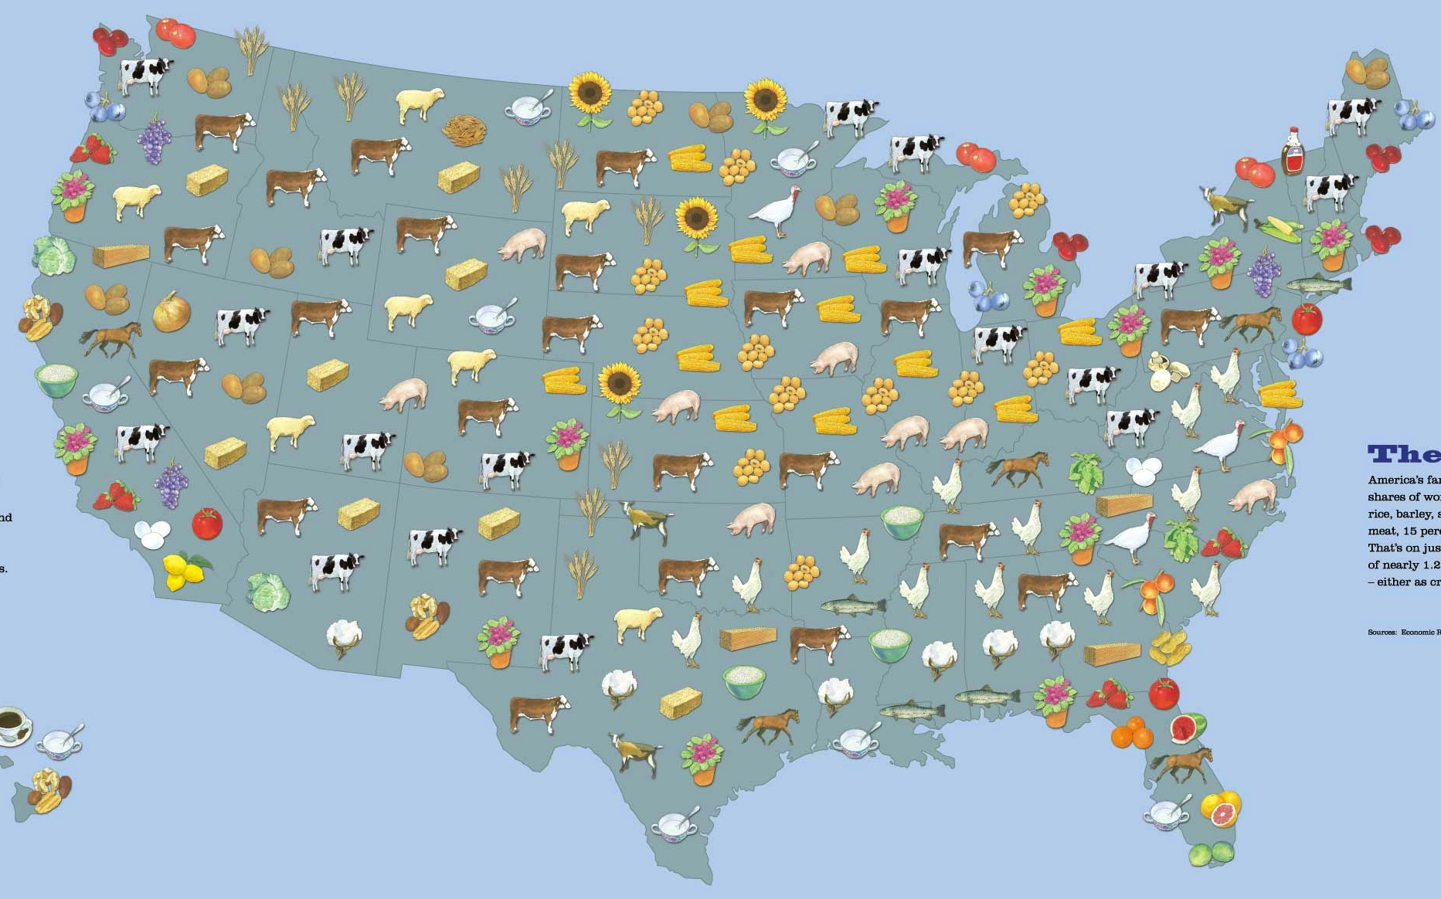
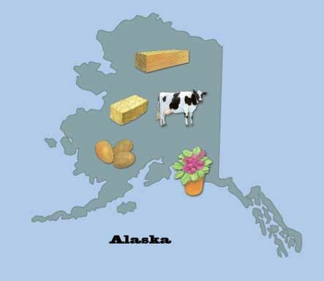
Agriculture the Bountiful!
Notes:
Source: AFBF

