Slide 1
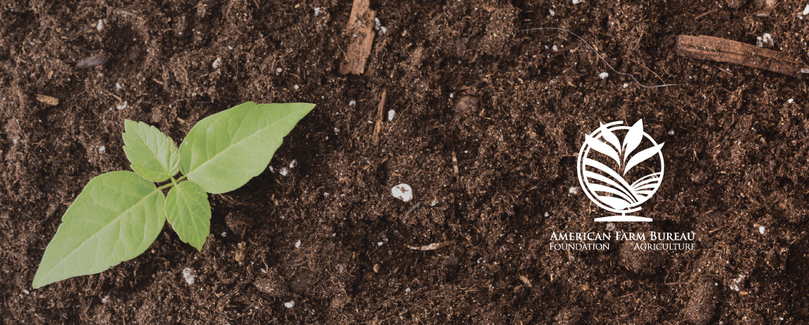
Feeding the Planet
Lesson 4 - Sustainable Agriculture: Production

Slide 2
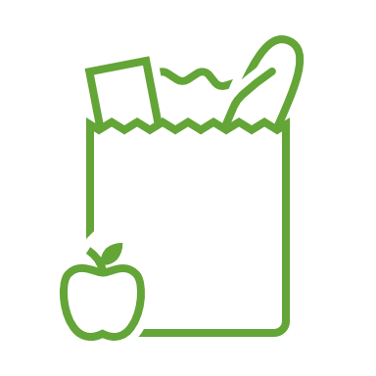
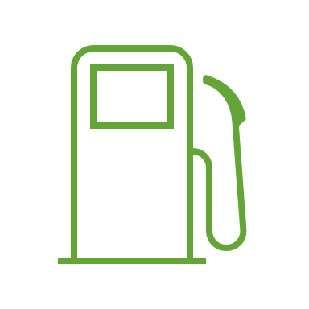
Brainstorm!
Food | Fiber
Fuel | Shelter

Slide 3
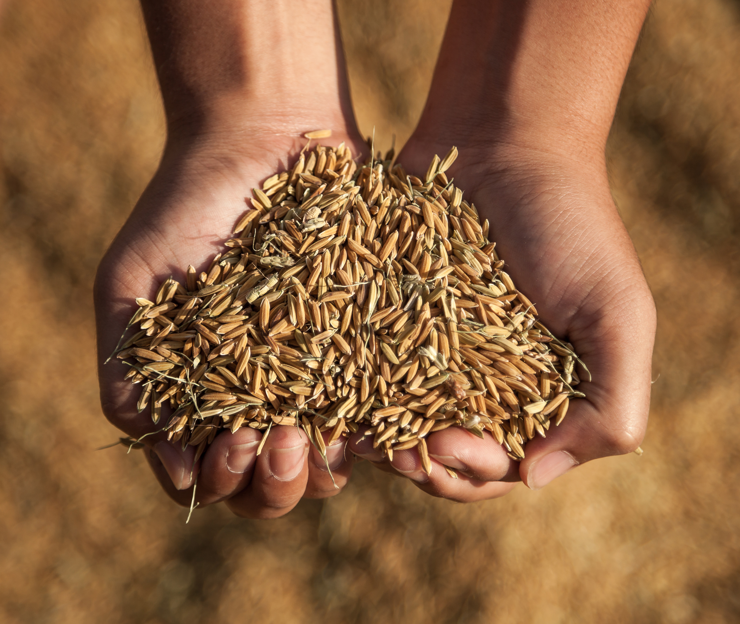
What Does It Mean to Be Food Secure?
Food secure: “no reported indications of food-access problems or limitations.”
Food insecure: “a household-level economic and social condition of limited or uncertain access to adequate food.”
Hunger: “an individual-level physiological condition that may result from food insecurity.”
Notes:
USDA ERS. (2016, October). Definitions of food security. Retrieved from https://www.ers.usda.gov/topics/food-nutrition-assistance/food-security-in-the-us/definitions-of-food-security

Slide 4
Why Would People Be Food Insecure?
Availability (and access)
Affordability
Quality and safety (and utilization)
Notes:
World Food Programme. (2017). What is food security? Retrieved from https://www.wfp.org/node/359289
The Economist Group. (2017). Global food security index. Retrieved from http://foodsecurityindex.eiu.com/Country

Slide 5
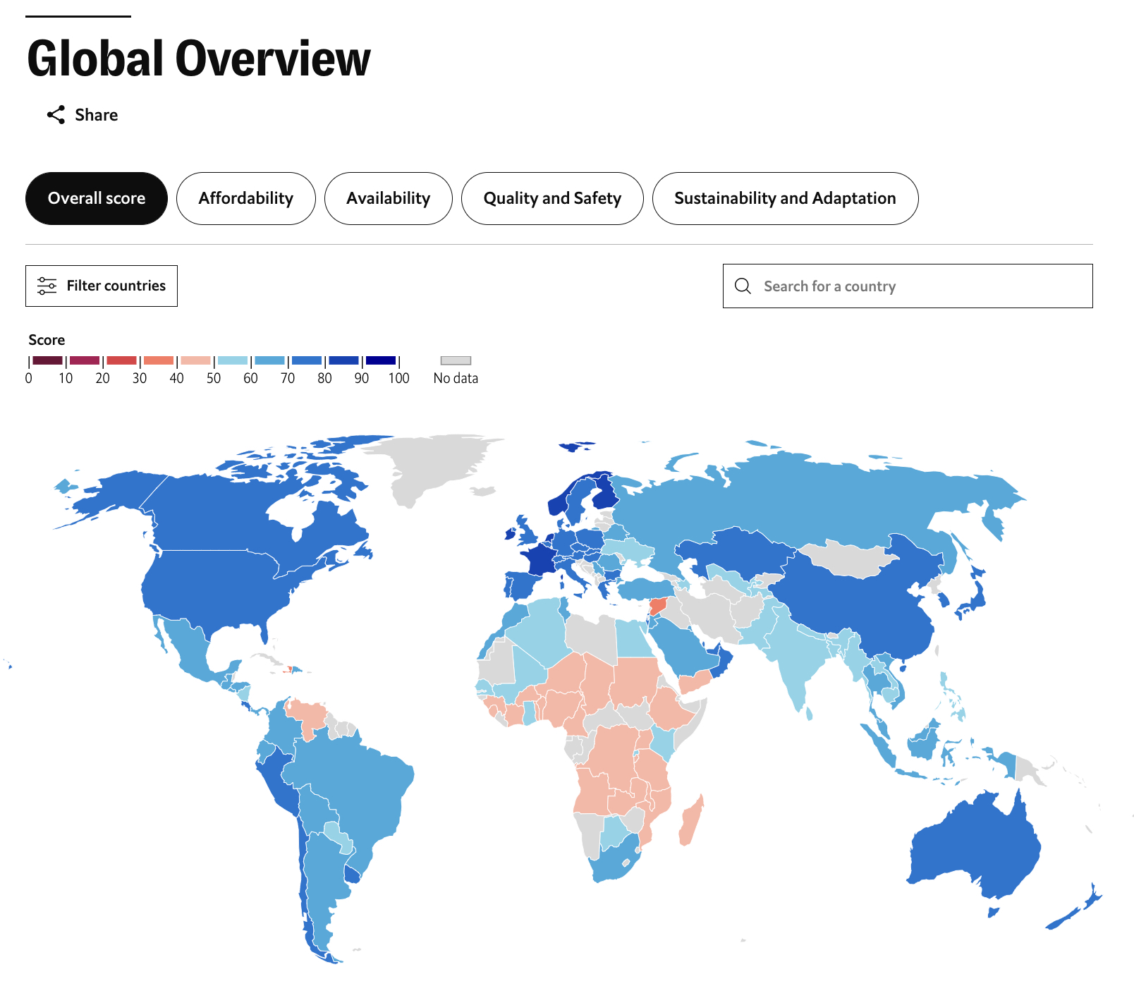
Food Security Infographic Needs to Include:
Country name
Overall food security ranking/score
Top strengths and challenges
Affordability
Availability
Quality and safety
Sustainability and Adaptation
Anything else you want, if you have time
Notes:
http://foodsecurityindex.eiu.com/Country
Screenshot from https://impact.economist.com/sustainability/project/food-security-index/

