Slide 1
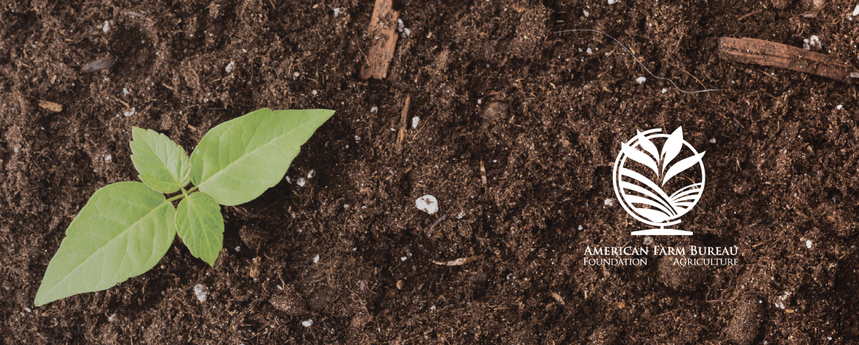
Environmental Stewardship
Lesson 3 - Sustainable Agriculture: Environment

Slide 2
Five Main Components
Soil quality and health
Water quality and availability
Air quality
Biodiversity
Animal health and welfare
Notes:
National Research Council of the National Academies. (2010). Toward Sustainable Agricultural Systems in the 21st Century. Washington, DC: National Academies Press.

Slide 3
Soil Quality & Health
What is soil?
“Soil is made of different sized mineral particles (sand, silt, and clay), organic matter, and numerous species of living organisms.”
What does it do for us?
Supports plant life
Helps cycle nutrients (e.g., water and carbon)
What are people talking about regarding the environment and soil?
Soil erosion – loss of topsoil from wind or water
Nutrient loss or imbalance – low fertility, high salinity, high pH, etc.
Soil compaction – reduced infiltration and increased runoff
Notes:
USDA NRCS. (2001, June.) Soil quality – Introduction. Retrieved from https://www.nrcs.usda.gov/Internet/FSE_DOCUMENTS/nrcs142p2_052207.pdf

Slide 4
Water Quality & Availability
Water Quality & Availability
What is water?
“A colorless, transparent, odorless, tasteless liquid that forms the seas, lakes, rivers, and rain and is the basis of the fluids of living organisms.”
What does it do for us?
Water is essential for growing crops and raising animals
What are people talking about regarding the environment and water?
Runoff and degradation – sediment, pesticides, and nutrients
Demand – Residential vs agricultural use and climate change
Pathogens – bacteria (e.g., E. coli)
Notes:
Oxford Dictionaries. (2017). Water. Retrieved from https://en.oxforddictionaries.com/definition/water
USDA NRCS. (2017). Agriculture & water quality in California. Retrieved from https://www.nrcs.usda.gov/wps/portal/nrcs/detail/ca/water/?cid=stelprdb1248443

Slide 5
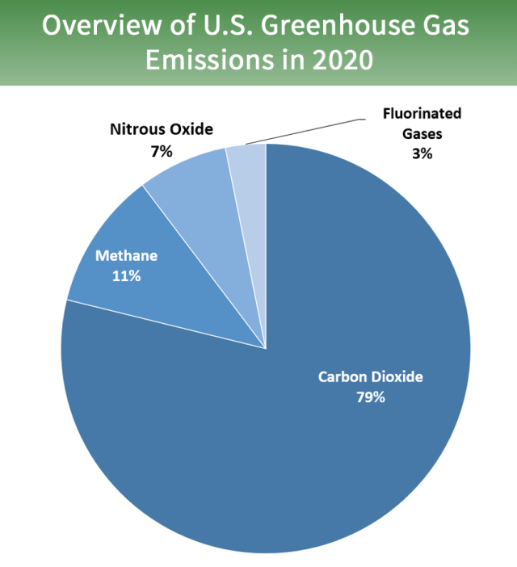
Air Quality
What is air?
“Air is the invisible gaseous substance surrounding the earth, a mixture mainly of oxygen and nitrogen.”
What does it do for us?
Plants and animals need air to stay alive
Plants use CO2 from the air to make food
What are people talking about regarding the environment and air quality?
Human health – Odor, particulate matter, and ozone precursors
Climate change – Greenhouse gases and carbon sequestration
Notes:
Oxford Dictionaries. (2017). Air. Retrieved from https://en.oxforddictionaries.com/definition/air
USDA NRCS. (2012, March). Air. Retrieved from https://www.nrcs.usda.gov/Internet/FSE_DOCUMENTS/stelprdb1187297.pdf
EPA (2022, May) Overview of Greenhouse Gases. Retrieved from https://www.epa.gov/ghgemissions/overview-greenhouse-gases

Slide 6
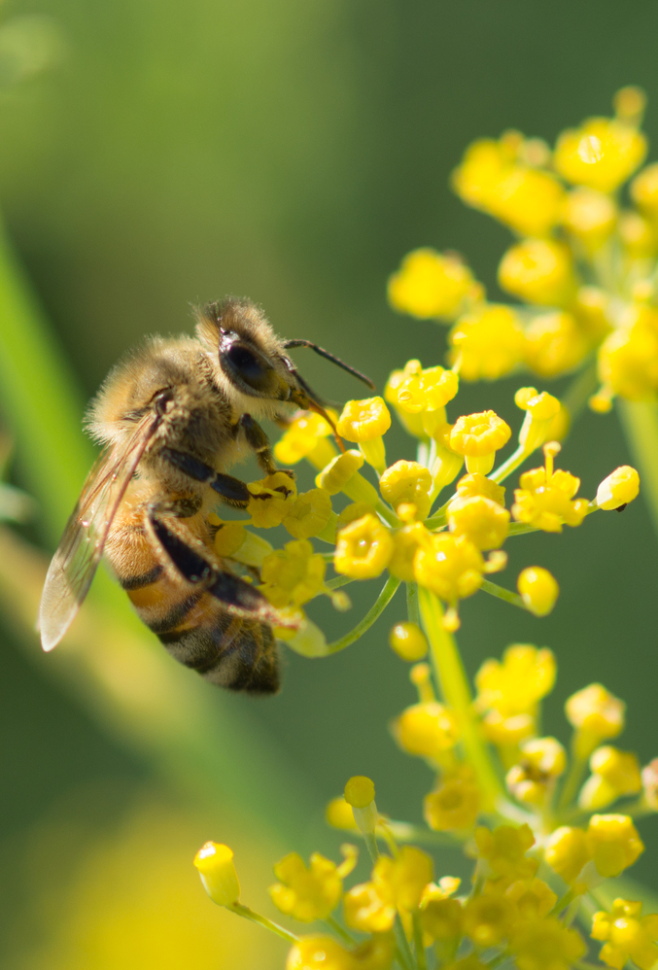
Biodiversity
Biodiversity
What is biodiversity?
The variety of life in the world or in a particular habitat or ecosystem.
What does it do for us?
Increases ecosystem resilience and increases production
What are people talking about regarding the environment and biodiversity?
Species diversity – animals, plants, insects, microbial
Habitat
Notes:
Oxford Dictionaries. (2017). Biodiversity. Retrieved from https://en.oxforddictionaries.com/definition/biodiversity

Slide 7
Animal Health &Welfare
What is animal health and welfare?
“Animal welfare requires disease prevention and veterinary treatment, appropriate shelter, management, nutrition, humane handling and humane slaughter.”
What does it do for us?
Promotes animal well-being and produces animal food products of the highest quality
What are people talking about regarding the environment and animals?
Climate change – methane gas and carbon sequestration
Feed and transportation
Notes:
American Veterinary Medical Association. (2017). Animal welfare: What is it? Retrieved from https://www.avma.org/KB/Resources/Reference/AnimalWelfare/Pages/what-is-animal-welfare.aspx

