Slide 1

Ag Literacy Strategic Planning Process
(Your organization)
(Presenter)
(Date)

Slide 2
How do we ensure our investment in ag literacy efforts yields results?
Central Question:

Slide 3
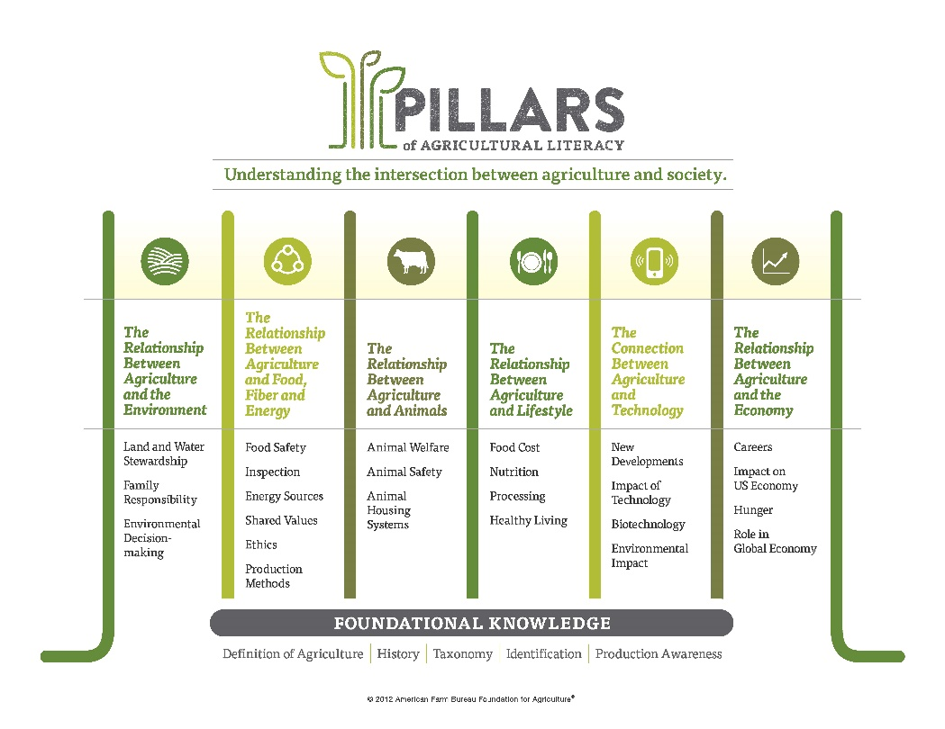
Pillars of Ag Literacy
Background
Shaped by the needs of the ag industry
Informed by academic research
Developed and adopted by American Farm Bureau Foundation for Agriculture in 2012

Slide 4
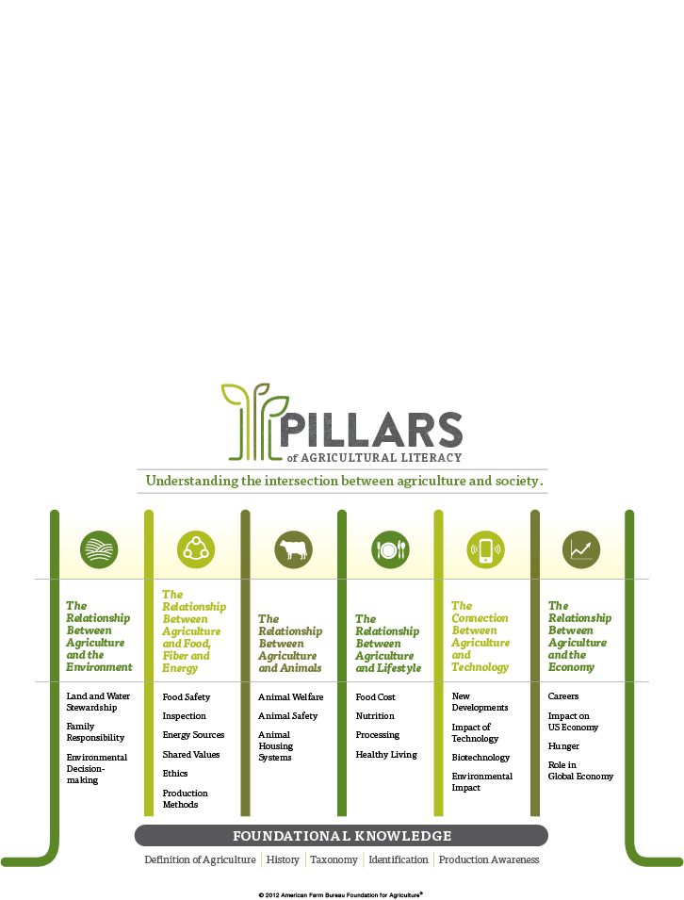

Slide 5
Begin With the End in Mind
Awareness
Knowledge Building
Analysis
Discovery
Informed Consumer and Voter

Slide 6
Our Process
Step 1 – Gather Input and Prioritize Efforts
Have Leaders/Key Stakeholders Complete Survey
Summarize and Analyze Results
Establish Priorities and Opportunities for Future Ag Literacy Efforts
Step 2 – Catalog and Review Current Efforts
List current ag literacy events and materials in worksheet and summarize relative success
Map each to Pillar, audience, and engagement method
Step 3 – Develop Strategic Plan for Future Ag Literacy Efforts
Determine which activities to keep, modify and/or replace
Develop schedule and plan
Communicate new strategic plan with others

