Slide 1
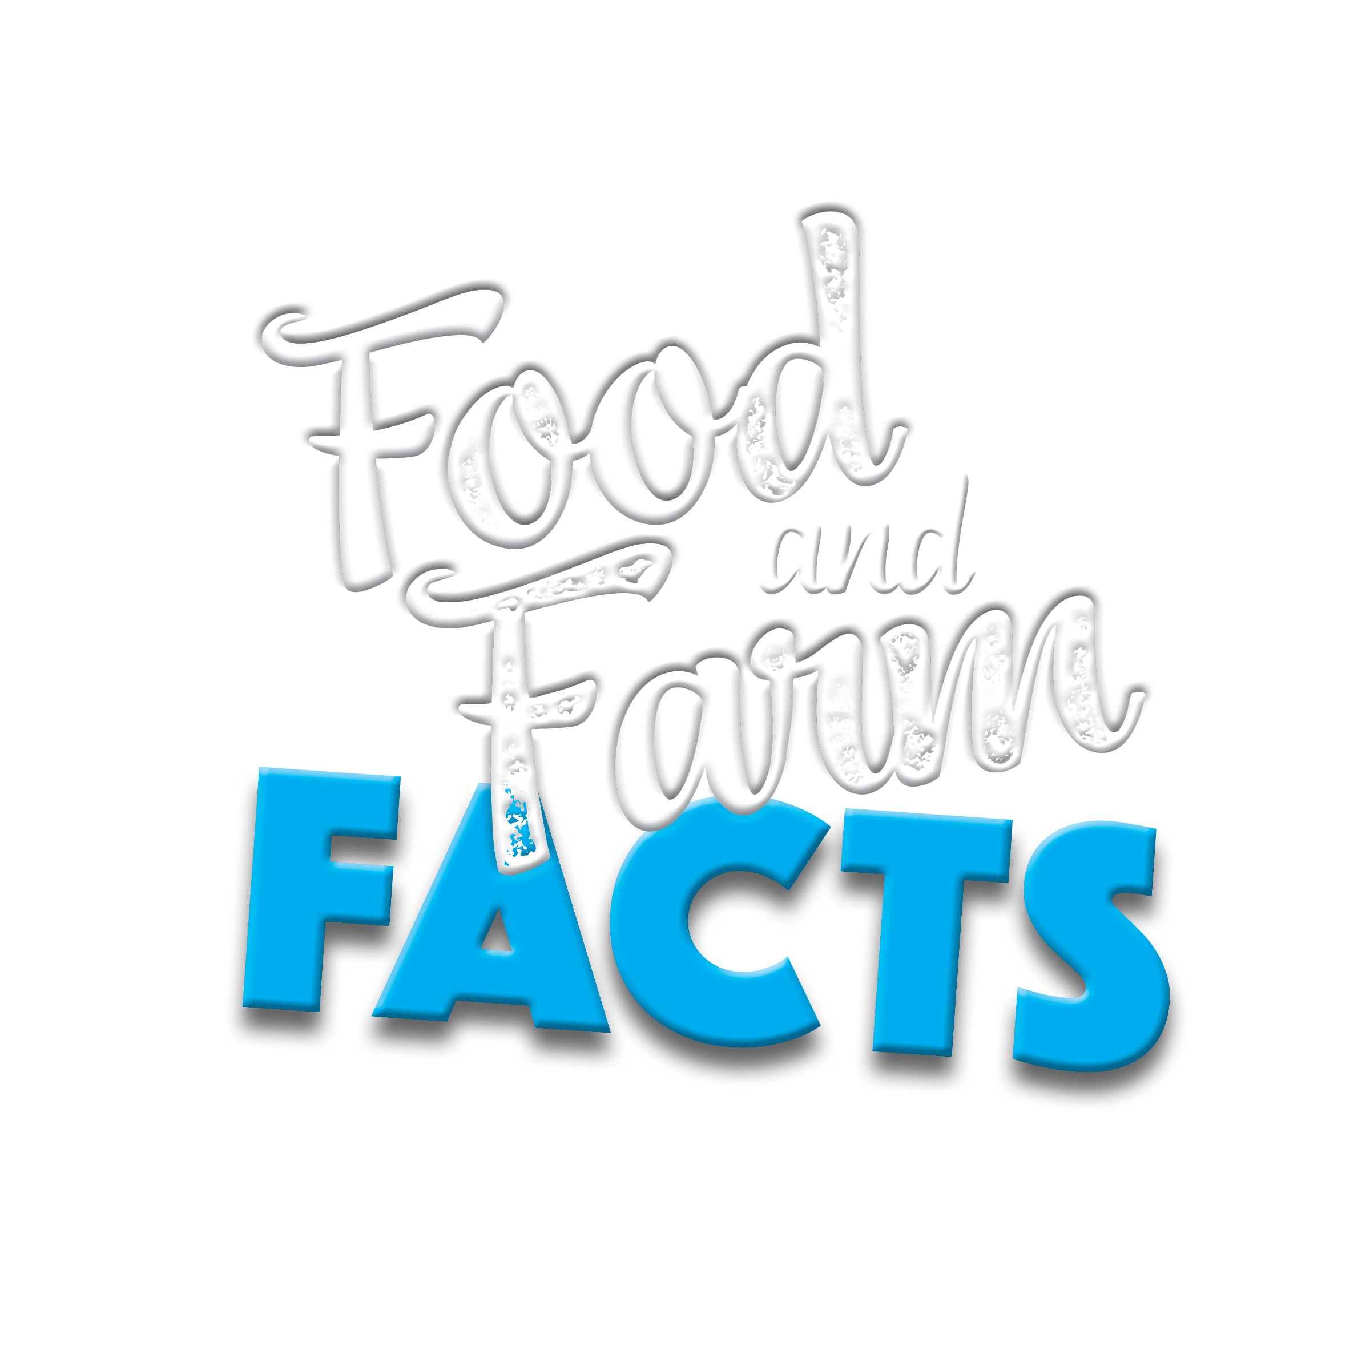
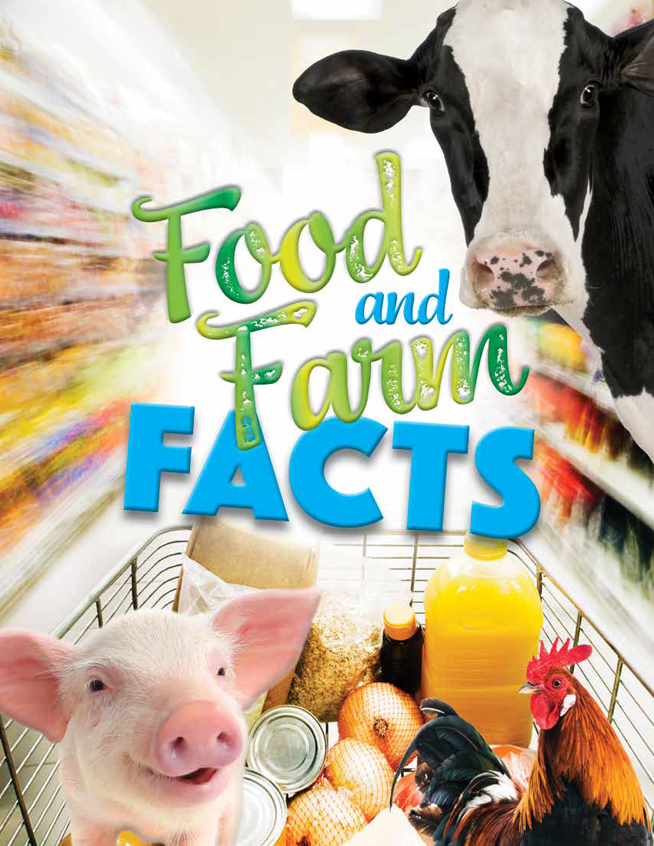
Notes:
Slide 1
Do: Have slide one projecting on screen as you are interacting with students before you begin your lesson.
NOTE: The purpose is to give students a slide to look at and become inquisitive about for the lesson about Food and Farm Facts.
Do: After you are done interacting and welcoming students. Begin lesson.
Say: Before we jump into who I am and why I am here, I have a big question for you. Give me a “Let’s do this” if you are ready!
Do: Proceed to slide two without introduction of yourself or why you are here. Also, if you feel comfortable with engaging the students more, you could ask the students to help you with a drumroll, to reveal the big question.

Slide 2
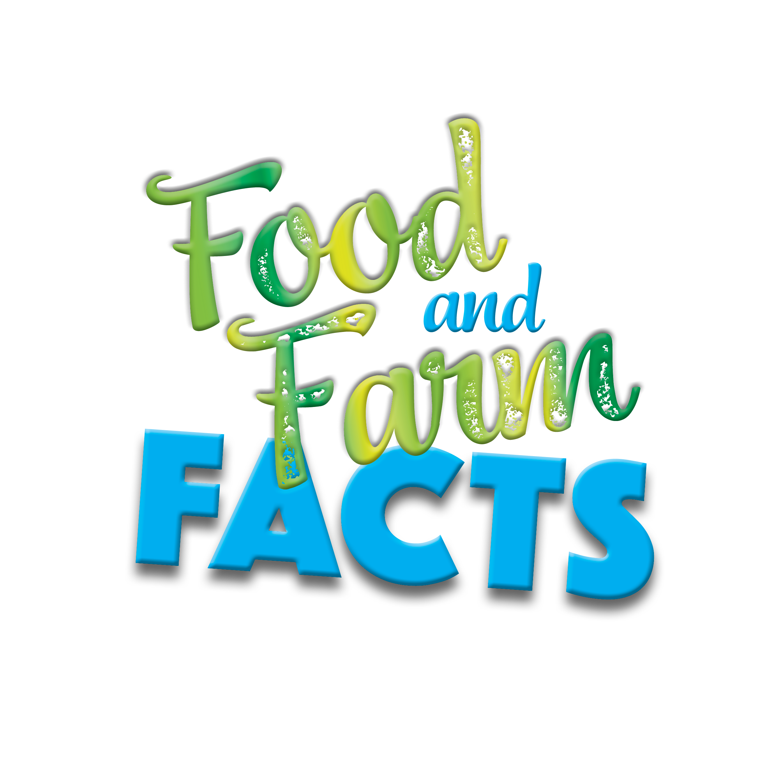
What do farmers look like?
Notes:
Slide 2
Ask: Who will be brave enough to volunteer to read the question on the slide?
Say: Thanks for volunteering! Go ahead and read the question loud and clear for everyone to hear.
Say: Great job! Now take 10 seconds to yourself and think about what a farmer looks like.
Do: Give students 10 seconds to think about the question and then move on to the rest of the lesson.
Say: Now that we have had time to think to ourselves about this question, turn to a partner and share what you came up with. Once the first person is done sharing, have the other person share what they thought a farmer looks like. Turn to a partner and start sharing!
Do: Give both students time to share their responses with one another. Continue with the lesson once both individuals have finished sharing.
Ask: Who will share what they talked about or heard from their partner?
Listen for: Overalls, boots, plaid shirts, straw hats, etc.
Do: Pick three volunteers to share.
Say: Thank you to all our volunteers for sharing! Although some farmers might dress in overalls and plaid shirts, most dress just like you and me. As a matter of fact, I am a farmer.
Do: Share a self introduction at this time. Be sure to include the following information.
Name
Hometown, State
Occupation in the Agricultural Industry
About your Operation
Your ”Why” for becoming a Farmer
Say: Just as I love my profession in the agriculture industry, I also love sharing cool facts about other parts of the industry. Today, we will not only explore awesome facts about agriculture, but we will all walk away with a better understanding of what agriculture is and why it is important to society.
Ask: But first, what does agriculture mean?
Do: Have two or three students share what they think agriculture is. Once the students have shared, move on to slide 3.

Slide 3
Agriculture means…
Food
Fiber
Energy
Notes:
Slide 3
Say: Agriculture is a big word that describes people who grow food, raise animals and produce energy for our world. I am involved with agriculture since I __________.
Do: Share again with students how you are involved with agriculture (E.g. raise cattle, farm wheat, am a seed scientist, etc.)
Say: Now that we know what farmers look like and what agriculture is all about, let’s discover some fun facts about them!
Do: Proceed to slide 4.

Slide 4
Let’s do an activity!
1. Read
2. Think
3. Hand
Notes:
Slide 4
Say: Let’s do an activity! I am going to read off a fact on the screen and it will be your job to think about if you believe the fact is true or false. I will reveal the answer as soon as everyone raises their hand for the fact being true or false. Let’s do a practice round to make sure everyone understands the instructions. Just remember: Read, think, hand.
Do: Go to slide five.

Slide 5
A farmer wears clothes just like you and me.
True or False
Notes:
Slide 5
Ask: A farmer wears clothes just like you and me. True or false?
Do: Wait 5 seconds for students to think if the answer is true or false.
Say: Raise your hand if you think the answer is true.
Do: Count how many students raise their hand.
Say: You may put your hands down. Now, raise your hand if you think the answer is false.
Do: Count how many students raise their hand.
Say: The correct answer is True! Just as we discovered earlier, farmers can wear lab coats, jeans, or dress just like you and I.
Ask: Does every understand how this activity will work?
Say: Great! Now that we all understand how the activity goes, let’s move on to the next slide to keep the learning happening!
Do: Proceed to next slide. Remind the students to think silently about their answer until you ask students to reveal if they think the fact is true or false.

Slide 6
Farmers and ranchers receive an average of 15% out of every retail dollar spent on food.
True or False
Notes:
Slide 6
Ask: Farmers and ranchers receive an average of 15% out of every retail dollar spent on food. True or false?
Do: Wait 5 seconds for students to think if the answer is true or false.
Say: Raise your hand if you think the answer is true.
Do: Count how many students raise their hand.
Say: You may put your hands down. Now, raise your hand if you think the answer is false.
Do: Count how many students raise their hand.
Say: The correct answer is True! On to the next slide!
Do: Proceed to next slide. Remind the students to think silently about their answer until you ask students to reveal if they think the fact is true or false.

Slide 7
The production of aquatic animals and plants under controlled conditions is Aquaculture.
True or False
Notes:
Slide 7
Ask: The production of aquatic animals and plants under controlled conditions is Aquaculture. True or false?
Do: Wait 5 seconds for students to think if the answer is true or false.
Say: Raise your hand if you think the answer is true.
Do: Count how many students raise their hand.
Say: You may put your hands down. Now, raise your hand if you think the answer is false.
Do: Count how many students raise their hand.
Say: The correct answer is True! The state of Maine currently produces the most marine aquaculture.
Ask: How cool is that? Now, whose ready for the next question?
Do: Proceed to next slide. Remind the students to think silently about their answer until you ask students to reveal if they think the fact is true or false.

Slide 8
More than 50% of farms market their products locally.
True or False
Notes:
Slide 8
Ask: More than 50% of farms market their products locally. True or false?
Do: Wait 5 seconds for students to think if the answer is true or false.
Say: Raise your hand if you think the answer is true.
Do: Count how many students raise their hand.
Say: You may put your hands down. Now, raise your hand if you think the answer is false.
Do: Count how many students raise their hand.
Say: The correct answer is False! Only 8% of farms market their products locally. Great job!
Ask: Was that a shocking number to anyone or does that seem about right?
Do: Listen for student responses then proceed to next slide.

Slide 9
40% of food grown and produced in the U.S. is never eaten.
True or False
Notes:
Slide 9
Ask: 40% of food grown and produced in the U.S. is never eaten. True or false?
Do: Wait 5 seconds for students to think if the answer is true or false.
Say: Raise your hand if you think the answer is true.
Do: Count how many students raise their hand.
Say: You may put your hands down. Now, raise your hand if you think the answer is false.
Do: Count how many students raise their hand.
Say: The correct answer is True!
Ask: Is anyone surprised by that number?
Do: Listen for student responses then proceed to next slide.

Slide 10
California has the most farms in the U.S.
True or False
Notes:
Slide 10
Ask: California has the most farms in the U.S. True or false?
Do: Wait 5 seconds for students to think if the answer is true or false.
Say: Raise your hand if you think the answer is true.
Do: Count how many students raise their hand.
Say: You may put your hands down. Now, raise your hand if you think the answer is false.
Do: Count how many students raise their hand.
Say: The correct answer is False! Texas currently has the most farms in the U.S.
Ask: Who is ready for the last slide?
Do: Proceed to next slide.

Slide 11
7% of the population are farmers and ranchers.
True or False
Notes:
Slide 11
Ask: 7% of the population are farmers and ranchers. True or false?
Do: Wait 5 seconds for students to think if the answer is true or false.
Say: Raise your hand if you think the answer is true.
Do: Count how many students raise their hand.
Say: You may put your hands down. Now, raise your hand if you think the answer is false.
Do: Count how many students raise their hand.
Say: The correct answer is False! Only 2% of the population are farmers and ranchers. That is such a small percentage of people for how much we rely on food, fiber, and energy.
Do: Proceed to next slide.

Slide 12
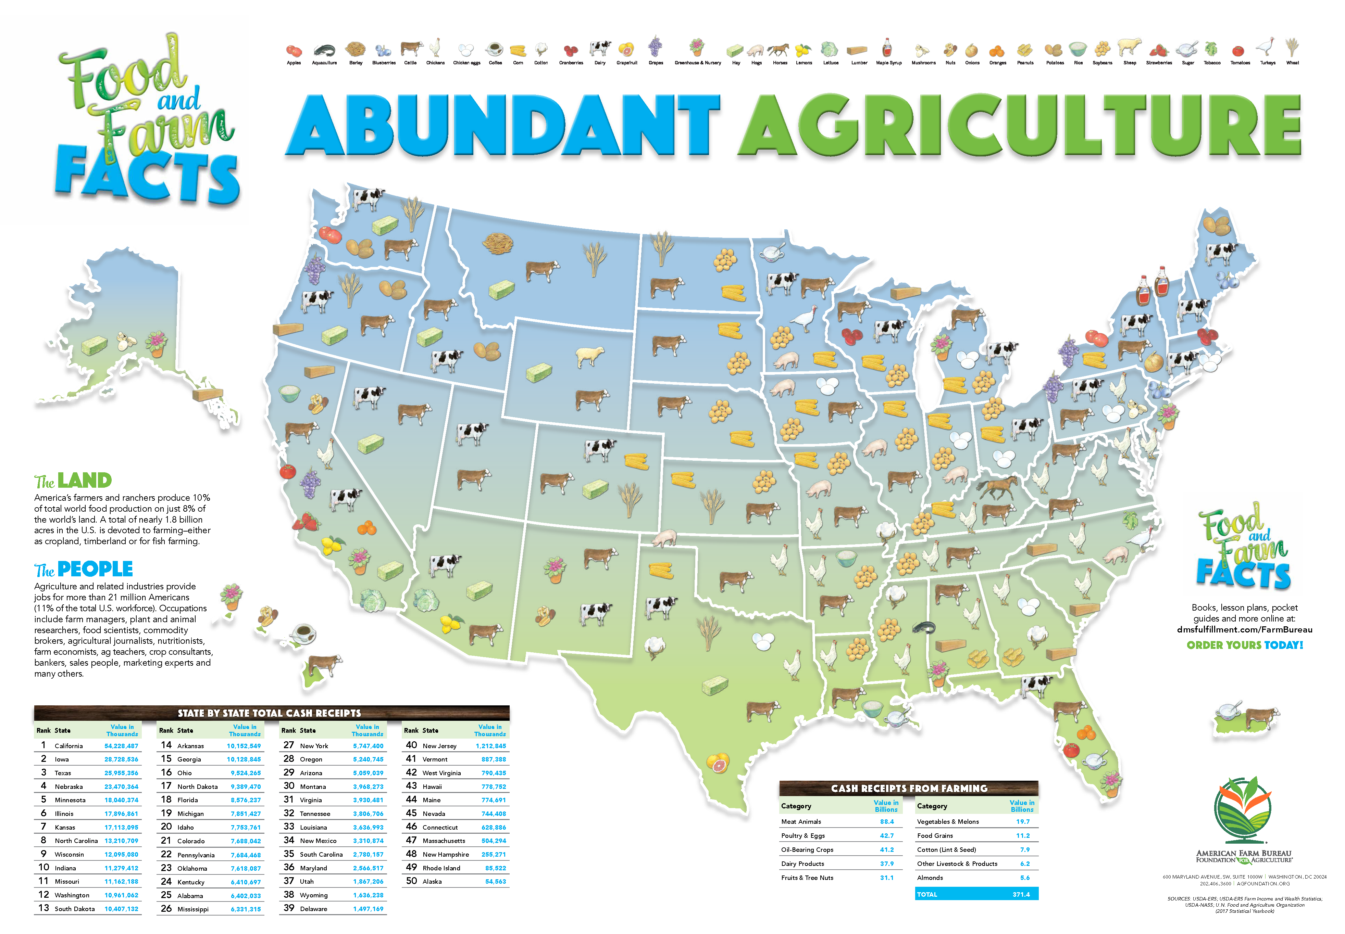
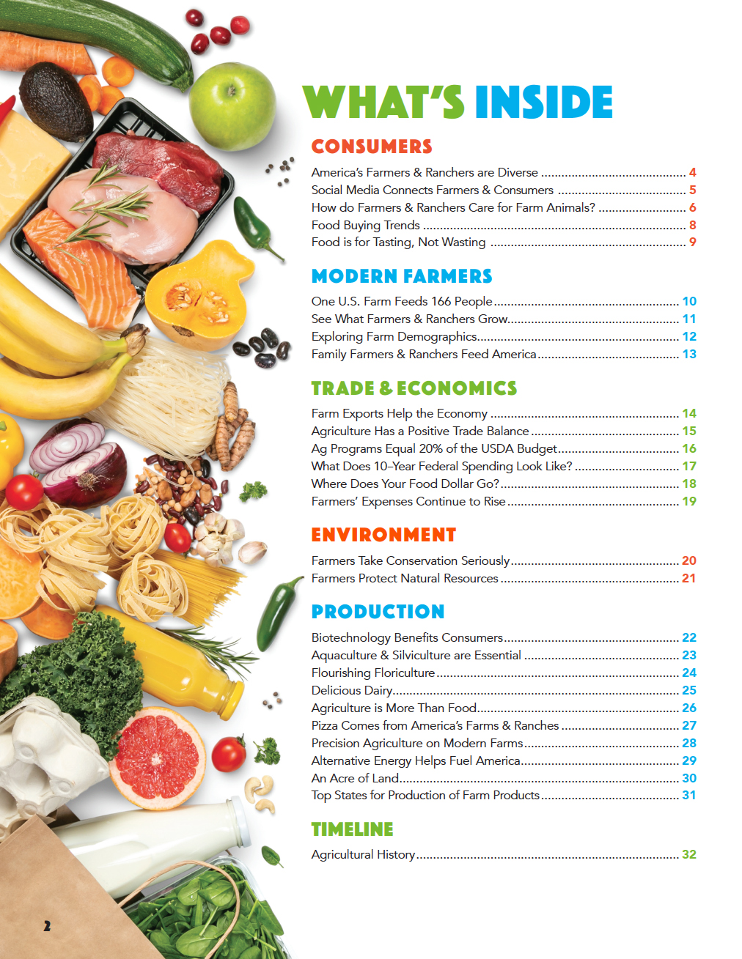
Where does our food come from and who grows it?
Notes:
Slide 12
Say: Thank you for your participation with this activity! You did a great job of thinking through all the Food and Farm Facts!
Ask: Isn’t it amazing knowing more about where your food comes from and who grows it?
Do: Proceed to next slide.

Slide 13
Notes:
Slide 13
Say: Today we have learned a lot of great information! We have discovered what real farmers look like, we have defined what agriculture is, and have played an awesome activity where we uncovered the truths about agriculture.
Do: If you have a Food and Farm Facts book or other resource that you are giving to the students, then pass them out at this time.
Ask: To wrap up our time together, who will share one fact that the learned today?
Do: Call on three volunteers to share.
Say: Let’s not forget what we learned here today. I challenge you to share with a classmate, sibling, or parent/guardian one fact that really stuck out to you from our time here together. Whether you thought it was interesting that 40% of food grown and produced in the U.S. is never eaten, or thought it was incredible that people involved in agriculture can also be fish farmers, share those facts with someone. Thank you for the enthusiasm and focus that you brought today!

