Slide 1
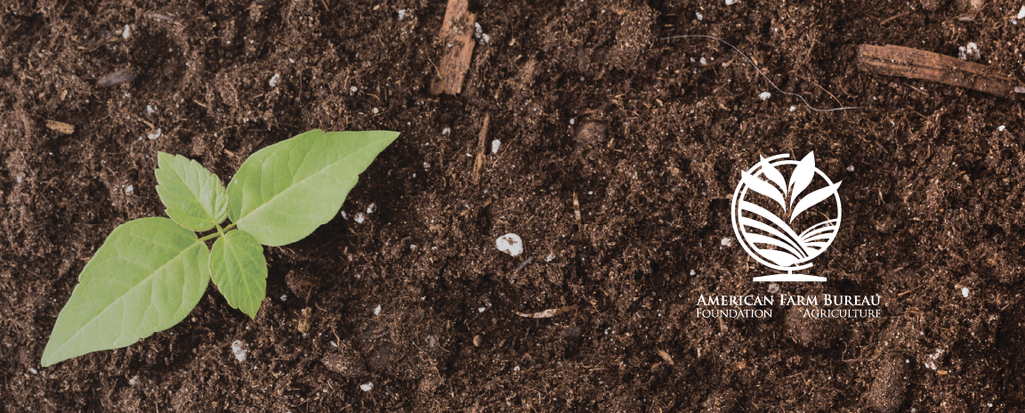
What is Sustainable Agriculture?
Lesson 1 - Sustainable Agriculture: Introduction

Slide 2
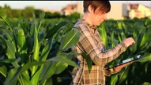
What Are The Challenges?
Notes:
https://www.youtube.com/watch?v=uAM4Si_WhDk - The Future of Agriculture by OECD Trade and Agriculture

Slide 3
KNOW
WANT
LEARN
What do you know?
What do you want to know?
What have you learned?

Slide 4
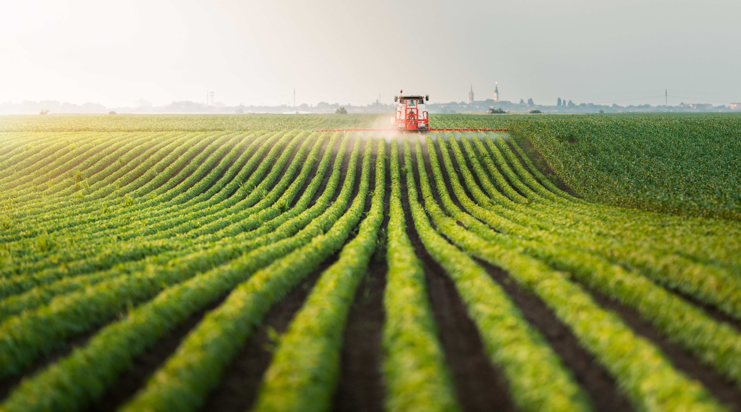
KEY TERMS
  Agriculture: “The science, art, or practice of cultivating the soil, producing crops, and raising livestock and in varying degrees the preparation and marketing of the resulting products.”
Notes:
Agriculture – Merriam-Webster Dictionary. (2017). Agriculture. Retrieved from https://www.merriam-webster.com/dictionary/agriculture
Sustainable - National Research Council of the National Academies. (2010). Toward Sustainable Agricultural Systems in the 21st Century. Washington, DC: National Academies Press.

Slide 5
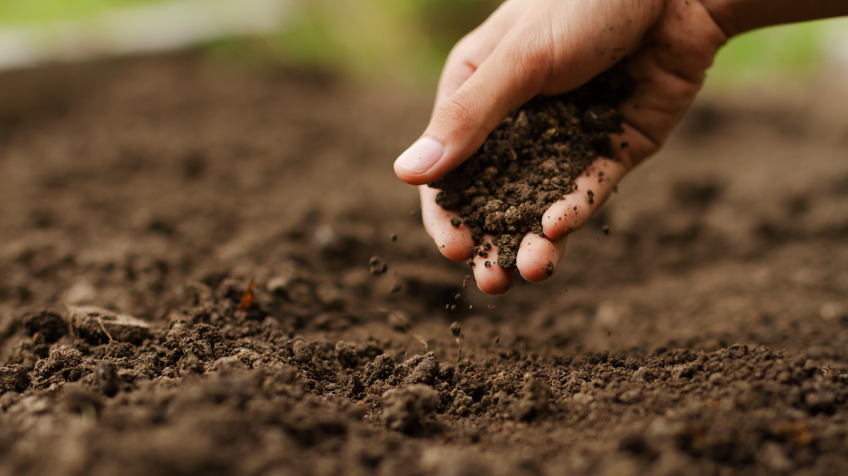
  Sustainable: “The ability to meet core societal needs in a way that can be maintained indefinitely without significant negative effects.”
Notes:
Agriculture – Merriam-Webster Dictionary. (2017). Agriculture. Retrieved from https://www.merriam-webster.com/dictionary/agriculture
Sustainable - National Research Council of the National Academies. (2010). Toward Sustainable Agricultural Systems in the 21st Century. Washington, DC: National Academies Press.

Slide 6
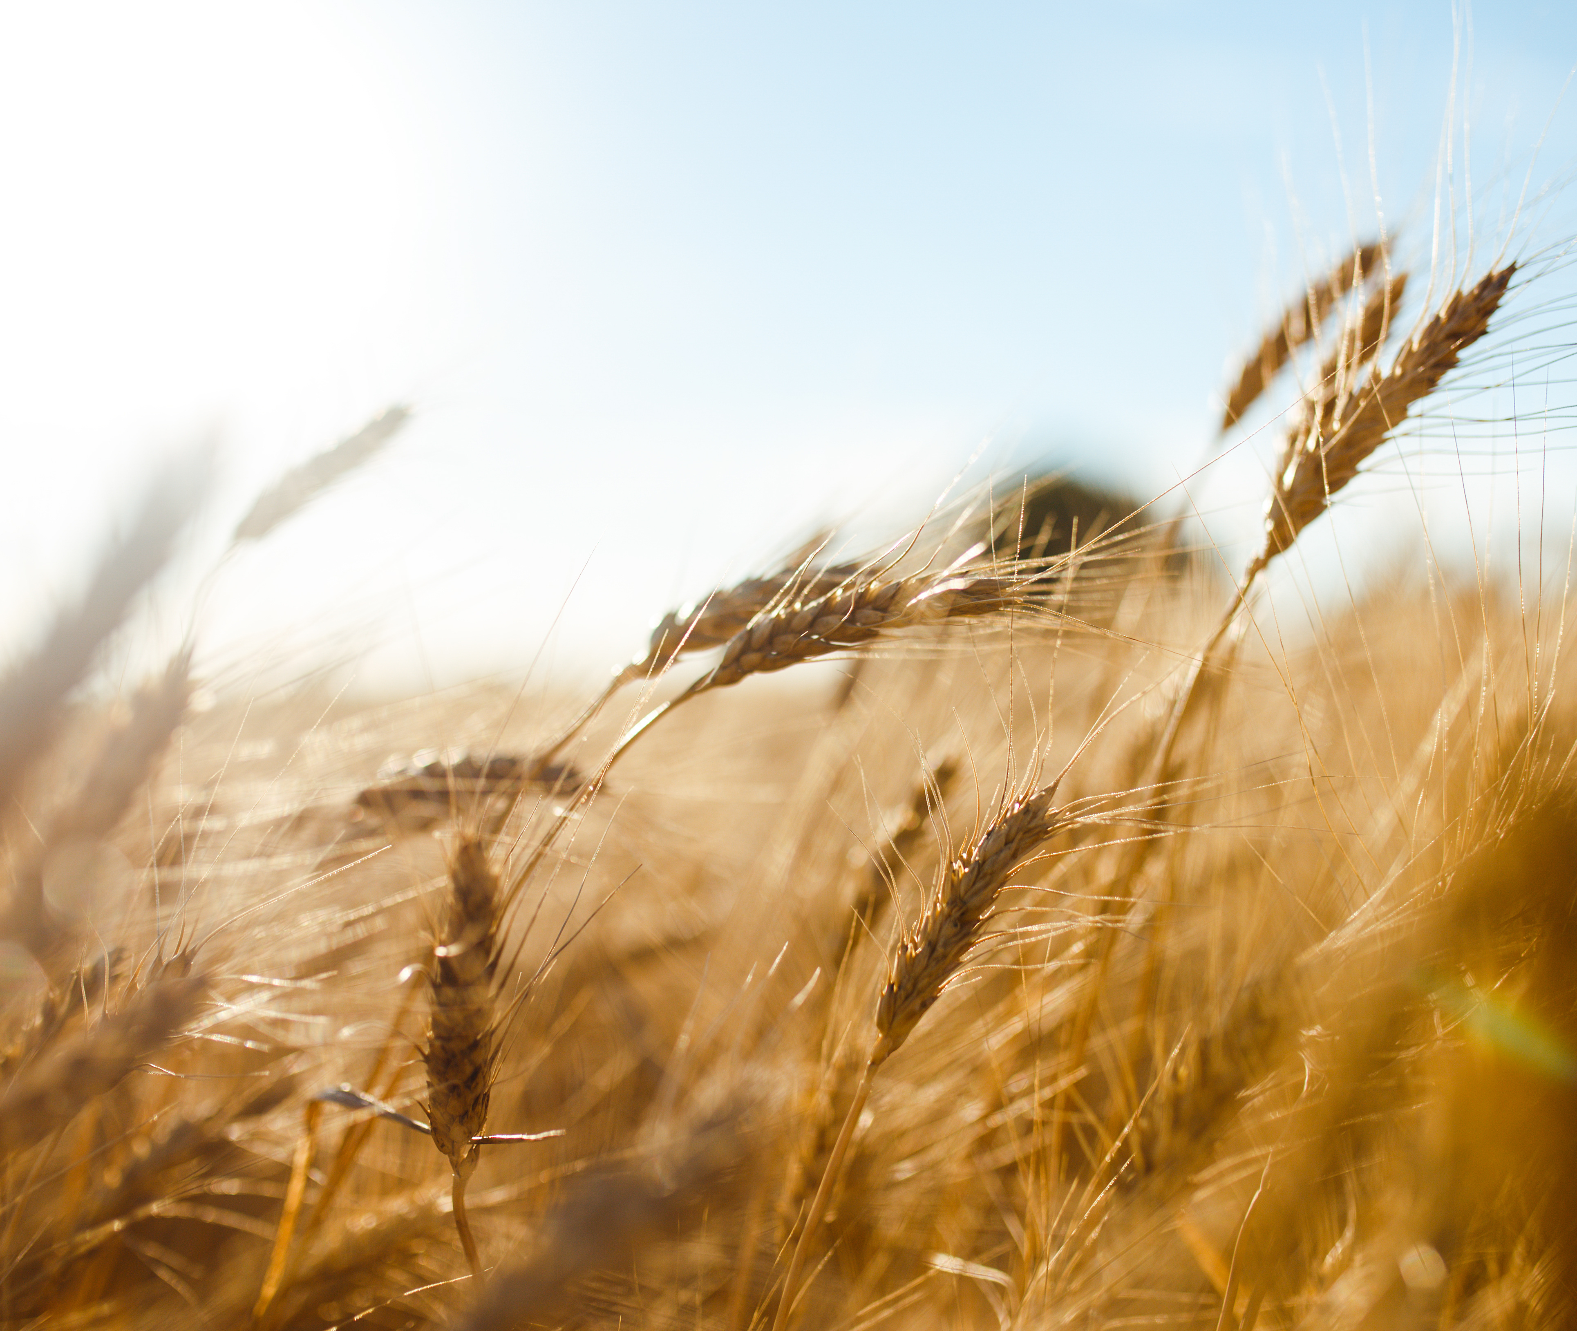
  Sustainable Agriculture:
  Satisfying production needs for human food, feed, fiber, and biofuel, enhancing environmental quality and quality of resource base, sustaining the economic viability of agriculture, and enhancing the quality of life for farmers, farm workers, and society as a whole.
Notes:
Sustainable agriculture – National Research Council of the National Academies. (2010). Toward Sustainable Agricultural Systems in the 21st Century. Washington, DC: National Academies Press.

Slide 7


Sustainable Agriculture Key Terms
Vulnerability: “The quality or capability of a system to be exposed to risk and uncertainty.”
Adaptability: “The ability of a system to evolve and change in response to long-term changes in the surrounding environment.”
Notes:
Vulnerability – Merriam-Webster. (2017). Vulnerable. Retrieved from https://www.merriam-webster.com/dictionary/vulnerability
Adaptability – National Research Council of the National Academies. (2010). Toward Sustainable Agricultural Systems in the 21st Century. Washington, DC: National Academies Press.

Slide 8



Resistance: “The ability of a system to resist being dislodged from a stable condition by a disturbance such as some sort of system stressors and fluctuating conditions."
Resilience: “The capacity of a system to absorb a spectrum of shocks or perturbations and still retain and further develop the same fundamental structure, functioning and feedbacks.”
Robustness: “The ability of a system to withstand stresses, pressures, and changes in circumstances.”
Notes:
Resistance – National Research Council of the National Academies. (2010). Toward Sustainable Agricultural Systems in the 21st Century. Washington, DC: National Academies Press.
Resilience – Chapin et al. (2009). Principles of ecosystem stewardship: Resilience-based natural resource management in a changing world.
Robustness – National Research Council of the National Academies. (2010). Toward Sustainable Agricultural Systems in the 21st Century. Washington, DC: National Academies Press.

Slide 9
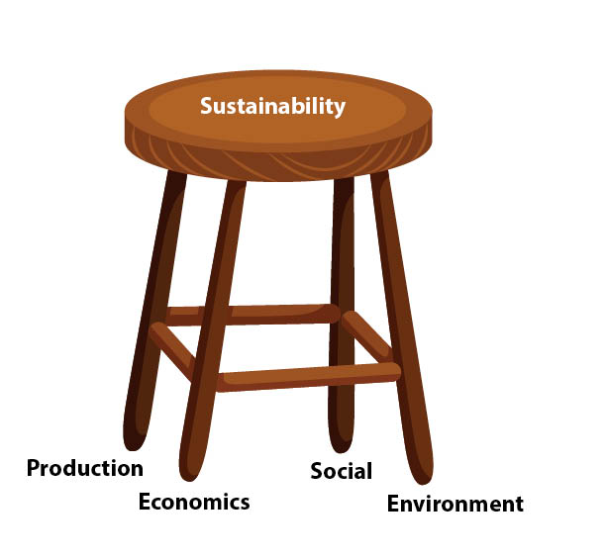
Agriculture sustainability is all about balance.

